Slide 1
Flocabulary 3
6th Grade Team

Slide 2
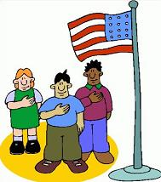
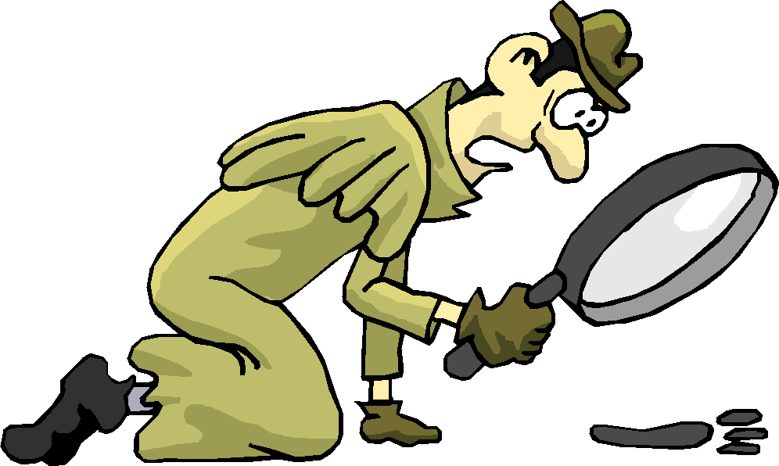
allegiance- loyalty or devotion
chronological- occurring or going in order of time
context- the background or situation for something
diligent- hard-working or thorough
generate- to produce or create

Slide 3
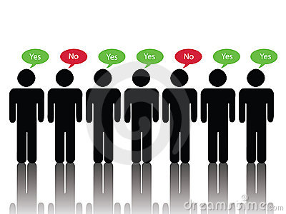
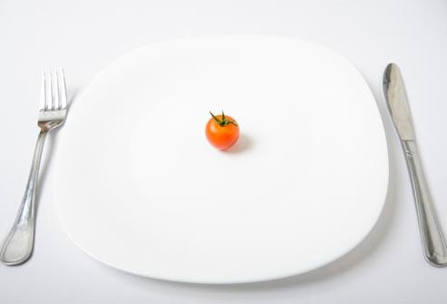
majority- the greater part or number
meager- not enough; inadequate
negotiate- to bargain; to try to reach a deal
obstacle- something that gets in your way; an obstruction
possess- to own, occupy or control

Slide 4
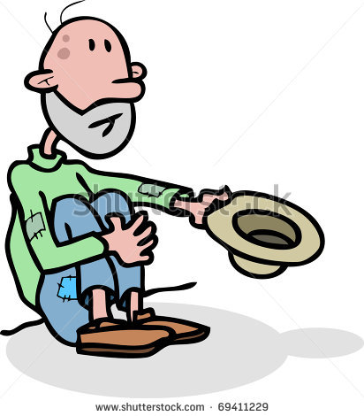
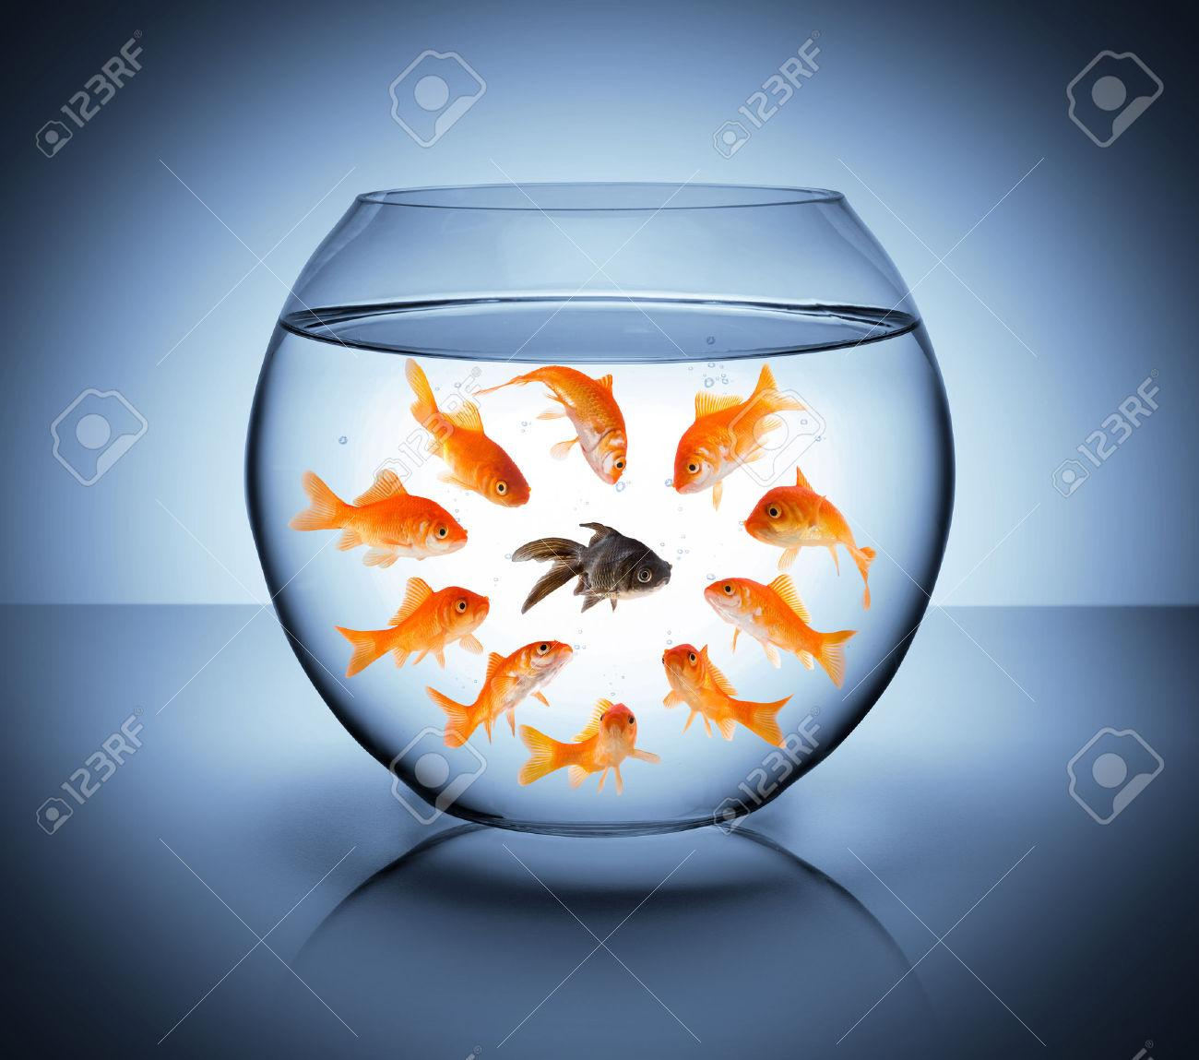
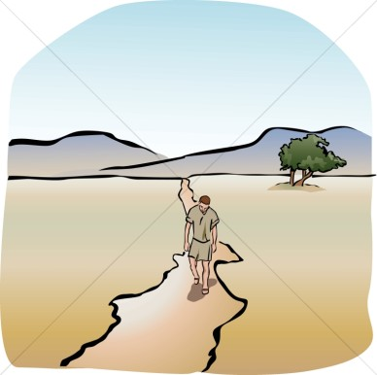
poverty- the state of being poor
prejudice- judging someone or something before you know much about them
prosecute- to accuse or put on trial
remote- far out of the way and distant
transform- to change

