Slide 1
5 Types of Nouns
Springfield Middle School
6th Grade Teachers

Slide 2
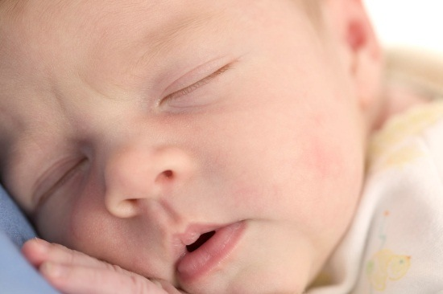
What are nouns???
A noun names a person, place, thing, or an idea.
For example:

Slide 3
Common and Proper Nouns
A common noun names any person, place, thing or idea.
Examples:
My book is on the table.
The girl went to school early this morning.
A proper noun names a specific person, place, thing or idea.
Examples:
My book, Long Walk to Freedom, is on the table.
Tamika goes to Caldwell Elementary.

Slide 4
Concrete and Abstract Nouns
A concrete noun names a material thing, person, or place. It is something that can be physically touched or perceived by the senses.
Examples:
A parade began at 7 o’clock
The cereal box is on the shelf.
An abstract noun names ideas, feelings, or qualities. They cannot be physically touched.
Examples:
Lynn wept in sorrow over the loss of her dog.
In the United States we have freedom.

Slide 5
Collective Nouns
Collective nouns name a group or collection of people, places, things or ideas. They are considered one unit and so they are singular.
Examples:
The crowd sounds like a herd of elephants.
The staff includes professionals and nonprofessionals.
The group of students is standing in line.

Slide 6
Here comes the tricky part…
Nouns can be more than one type!!!
Example:
Milk is both common and concrete
Dr. Wong is both proper and concrete
Now you try….

Slide 7
*Partner time*
With your partner write what type of noun(s) the following are:
dog
Lucama, NC
love
class
Springfield Middle School

